Slide 1

XN PROJECT: eda presentation(GROUP)
College of Professional Studies, Northeastern University
Sean McLean
Paula Andrea Romero Melo
Gauri Udaysing Shinde
Ted Smith

Slide 2
INTRODUCTION
Introduction of Project
Executive Summary
Business Problem
Analytics / Visuals
Recommendations & Findings
Future Research

Slide 3
Executive summary
Objective: Identify areas of interest for Yeoman Technology Group.
Dataset Analysis: Each member found patterns providing insights for potential deliverables.
Focus Areas: Market Share Clicks and Search Query.

Slide 4
Business problem
Challenge: Help pre-Internet brands improve digital sales without disrupting existing wholesale and retail channels.
Strategy: Utilize Amazon data to enhance client understanding of pricing, advertising, and merchandising programs.
Goal: Create scalable Brand Influence and Ad Spend Optimization models to improve advertising strategies and brand positioning on Amazon.

Slide 5
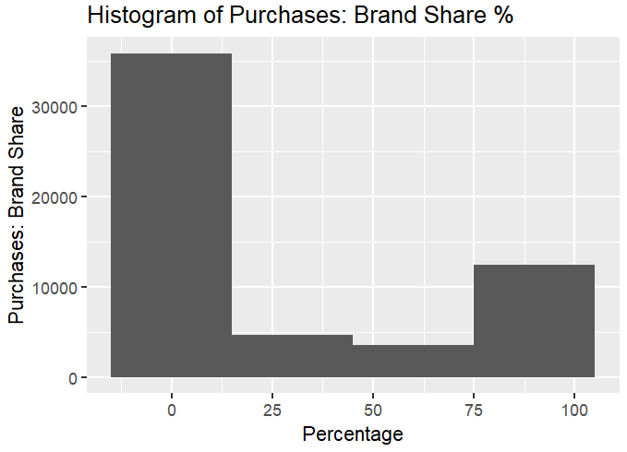
Analytics/visuals
Key Insights from Brand Share Histogram
Market Dominance: Few brands dominate with high percentages.
Barriers to Entry: High prevalence of 0% indicates strong brand loyalty and high entry costs.
Competition Intensity: Significant gap between 0% and dominant brands.
Market Maturity: Concentration at extremes indicates a mature market.

Slide 6
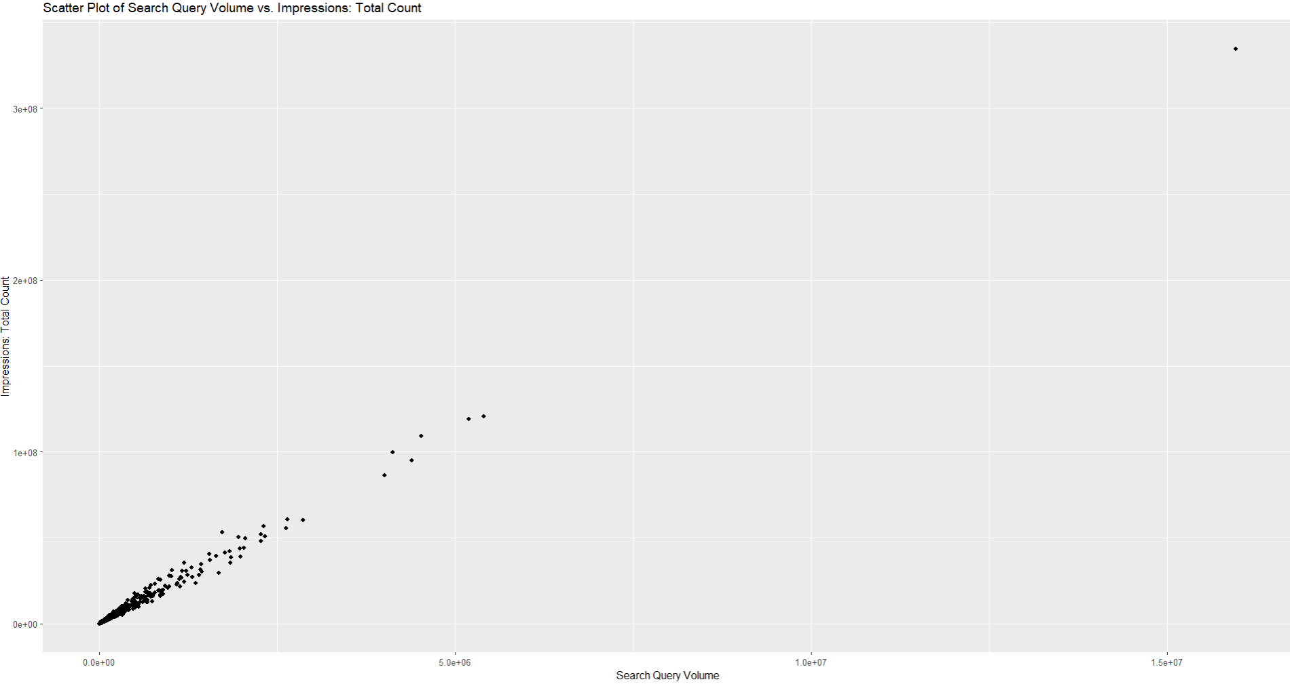

Search query volume Vs. impressions: total count
Observation: Linear relationship between search query volume and ad impressions.
Implication: Focusing advertising on high search query areas can increase ad visibility.

Slide 7
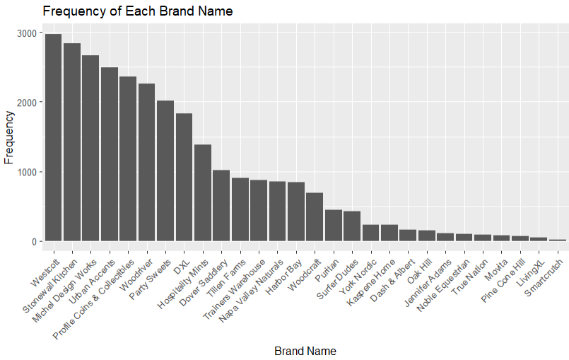
BRANDS FREQUENCY
Brand Popularity.
Strong market presence in the top 5 of brands.
Lower frequencies may be niche players or newer entrants.
No evidence of outliers.

Slide 8
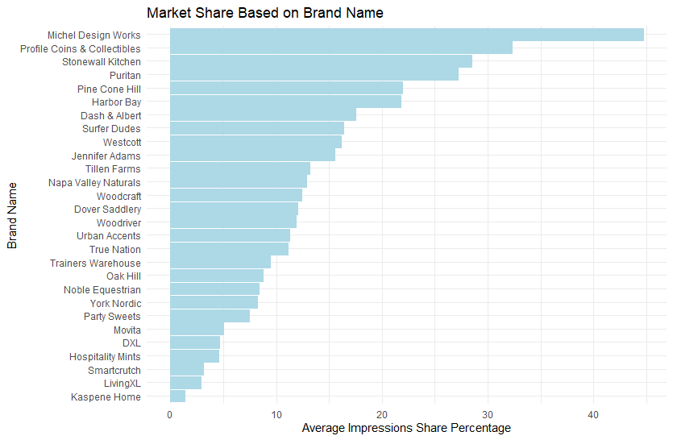
MARKET SHARE BY COMPANY
There is a definite wide range of market share for each of the companies/brands.
Smaller market share has potential for greater percentage increase in sales and or profit.
Are the smaller brands willing to put up the effort and capital to try changing?

Slide 9
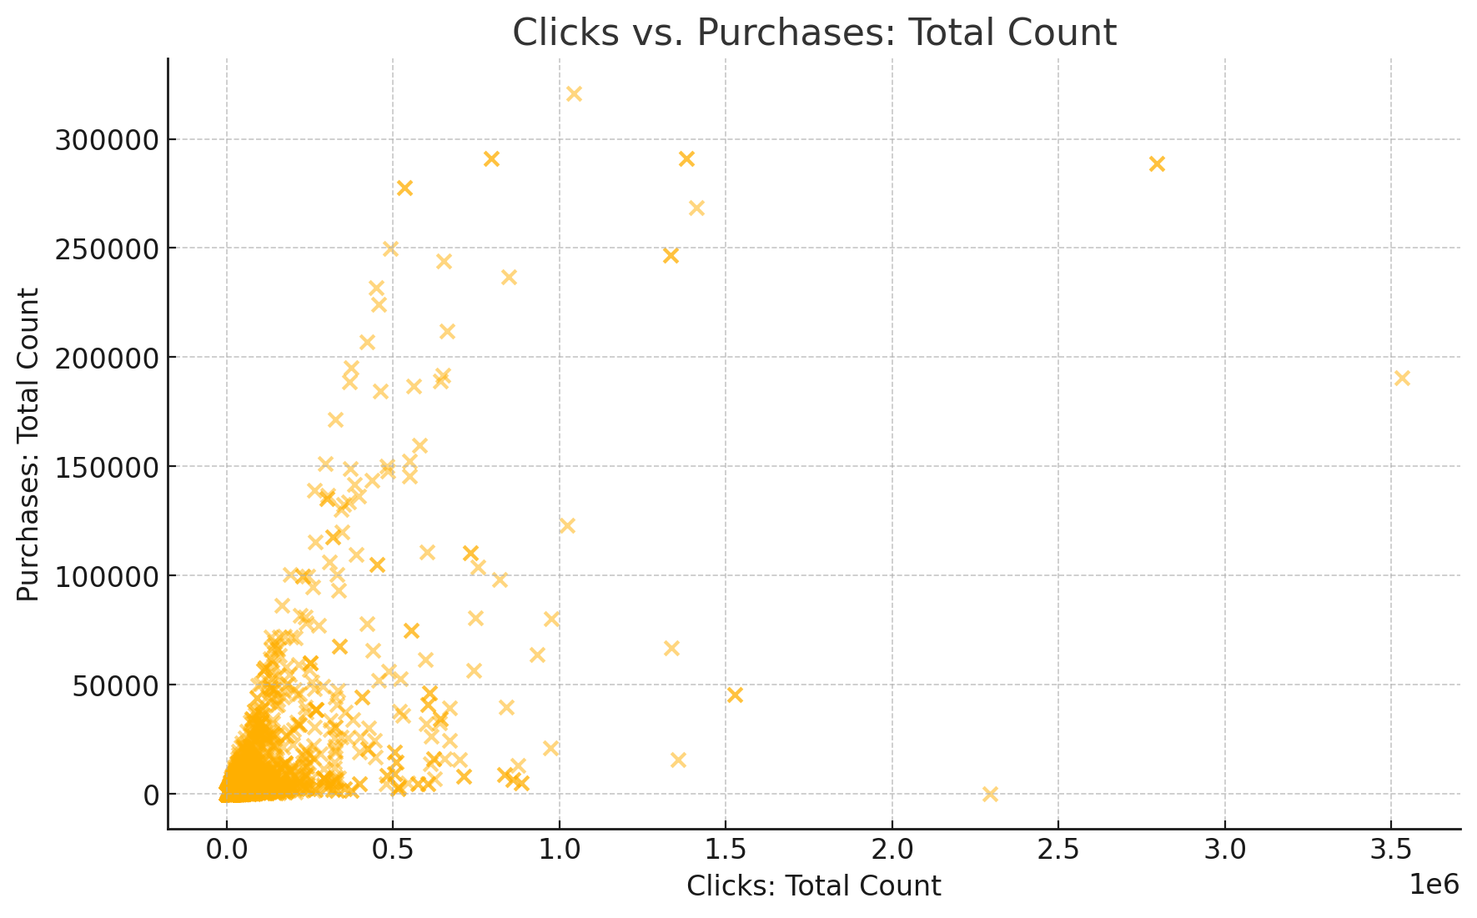

Clicks vs. Purchases: Total Count
Data Concentration: Most queries have low clicks and purchases, indicating low engagement and conversion.
Outliers: Some queries have high clicks but low purchases.
Recommendation: Optimize high-click, low-purchase queries to improve performance.

Slide 10
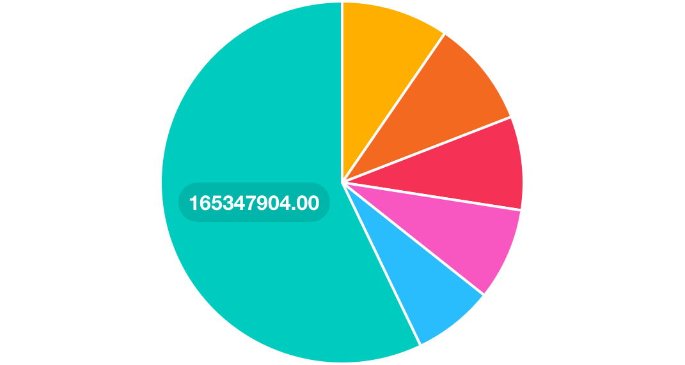
Simplified Distribution of Clicks by Brand
Dash & Albert: Largest share of clicks, high user interest.
Kaspene Home: Substantial portion of clicks, reflecting strong brand visibility.
Urban Accents: Significant share, suggesting effective query performance.
PineCone Hill: Moderate clicks, indicating steady user interest.
Stonewall Kitchen: Noticeable portion of clicks, showing competitive engagement.
Others: Aggregated smaller brands, highlighting dominance of top brands.

Slide 11
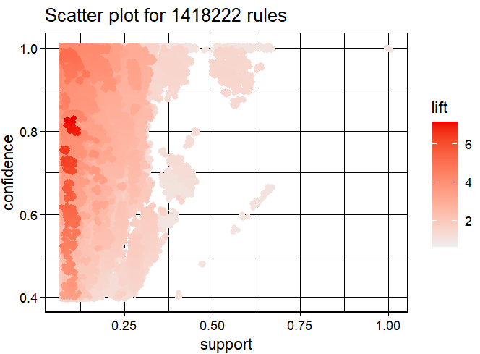
Association mining of dataset
Understanding Key Metrics:
Support, Confidence, and Lift.
Interpreting the Scatter Plot:
Reliable item sets with high support and confidence, potential cross-selling opportunities with high lift.
Implications for Amazon:
Identifying common combinations, targeted marketing, enhancing recommendation systems.

Slide 12

Recommendations and findings
Optimize High-Click, Low-Purchase Queries:
Observation: High clicks, low purchases.
Recommendation: Improve conversion rates by addressing barriers and enhancing product page appeal.
Promote High-Lift Item Sets for Cross-Selling:
Observation: Strong associations between products.
Recommendation: Design cross-selling strategies by recommending these items together.
Leverage Brand Insights:
Observation: Insights on popular and niche brands.
Recommendation: Grow market share for popular brands; increase visibility for niche brands with targeted marketing.

Slide 13

Future research
Continued refinement of analysis to provide specific guidance.
Exploring temporal trends to understand seasonal trends and long-term shifts.
Advanced predictive modeling to forecast future sales trends and customer preferences.

Slide 14
REFERENCES
Chaffey, D. (2020). Digital marketing strategy: Implementation and practice. Pearson.
Champigny, A. (2024, May 18). 6 Ways to Measure Your Consulting Firm’s Performance. Deltek.
Fathalla, A., Salah, A., & Ali, A. (2023). A Novel Price Prediction Service for E-Commerce Categorical Data. Mathematics (Basel), 11(8), 1938- . https://doi.org/10.3390/math11081938
Guiding Metrics. (2024, May 18). The Management Consulting Industry’s 10 Most Critical Metrics.
Shopova, R. (2023). Private labels in marketplaces. International Journal of Industrial Organization, 89, 102949-. https://doi.org/10.1016/j.ijindorg.2023.102949
Stokes, R. (2014). eMarketing: The essential guide to marketing in a digital world. Quirk eMarketing.
Zhang, J., & Nault, B. R. (2024). Upstream information sharing in platform-based e-commerce with retail plan adjustment. DECISION SUPPORT SYSTEMS, 177, 114099-114111. https://doi.org/10.1016/j.dss.2023.114099

